Slide 1
The Clinical Potential of EEG Functional Connectivity Analysis
Steven L. Bressler
Cognitive Neurodynamics Laboratory
Center for Complex Systems & Brain Sciences
Florida Atlantic University

Slide 2
Overview
1. Functional Connectivity of macaque cortical LFPs
a. Sensori-Motor System
b. Visual System
c. Parieto-Frontal System
2. Functional Connectivity of human patient cortical
BOLD signals
3. Implications for use of Functional Connectivity of human patient EEG source signals

Slide 3
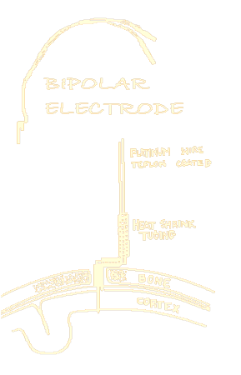
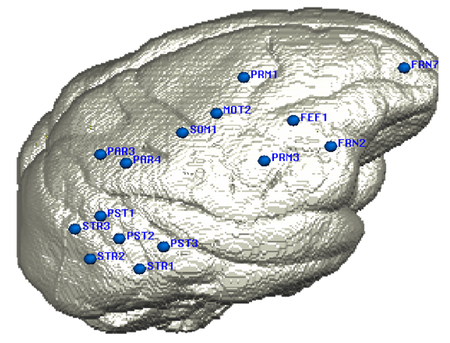
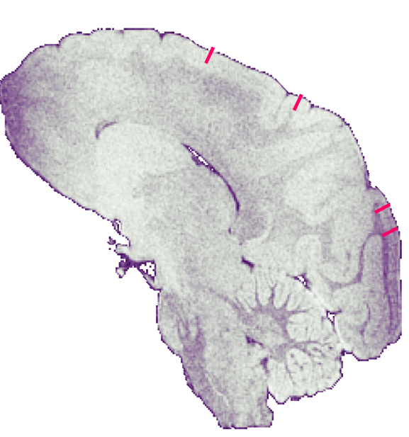
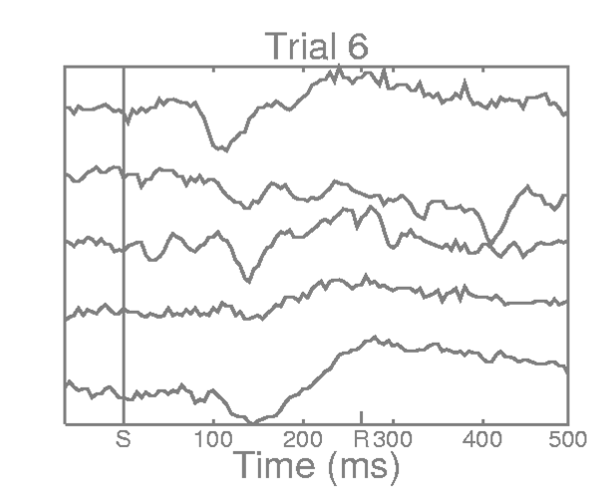
Nakamura-Coppola Recording Paradigm
Chronic Implant of Bipolar Electrodes
Multiple Distributed Electrode Sites
Simultaneous LFP Recording

Slide 4
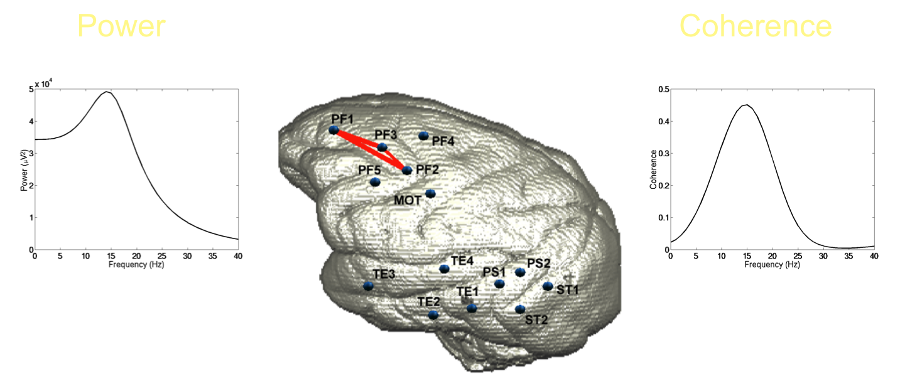
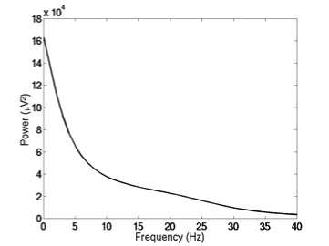
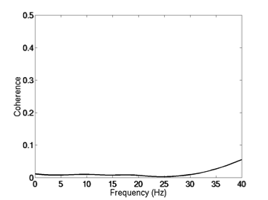
Functional Connectivity of Cortical LFPs in Macaque Prefrontal Cortex Liang et al, Neuroreport, 2002
Synchronized beta rhythms form a large-scale set-related network.
Non-network
Prefrontal

Slide 5
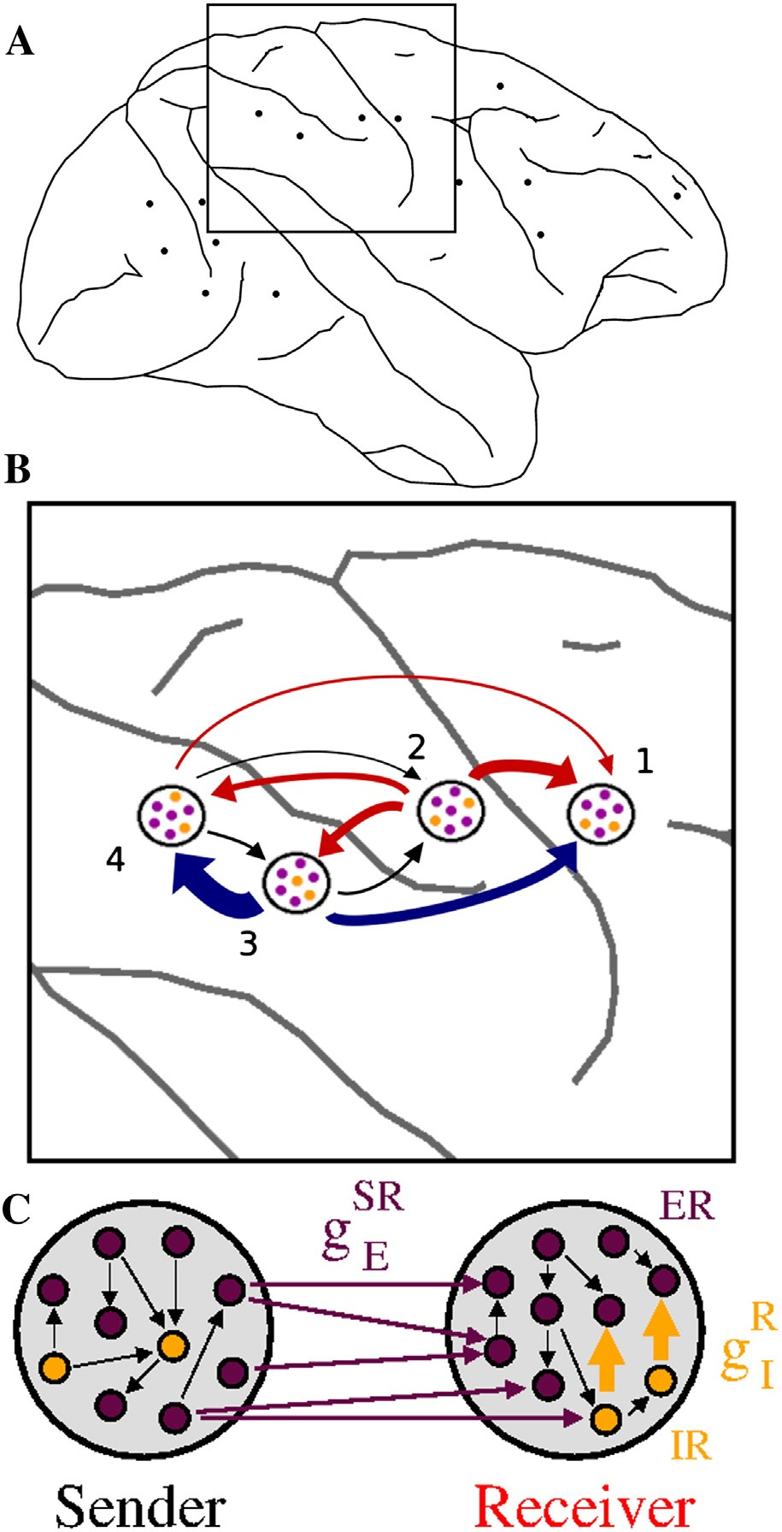
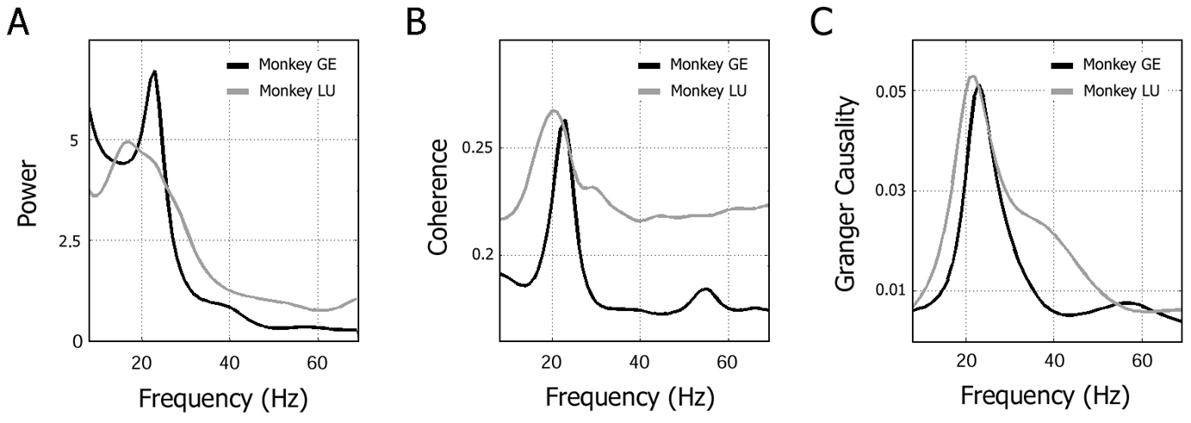
Functional Connectivity of Cortical LFPs in Macaque Somatosensory-Motor System Brovelli et al., 2004, PNAS Matias et al. 2014, NeuroImage
Functional Connectivity analysis using AR-based spectral analysis was successfully applied to Local Field Potentials (LFPs) from the somatosensory & motor cortices in the monkey.
Functional Connectivity was seen as interareal oscillatory synchrony & directed influences in the beta frequency range.
The flow of directed influence suggested that somatosensory feedback modulates the motor cortex in motor maintenance.

Slide 6
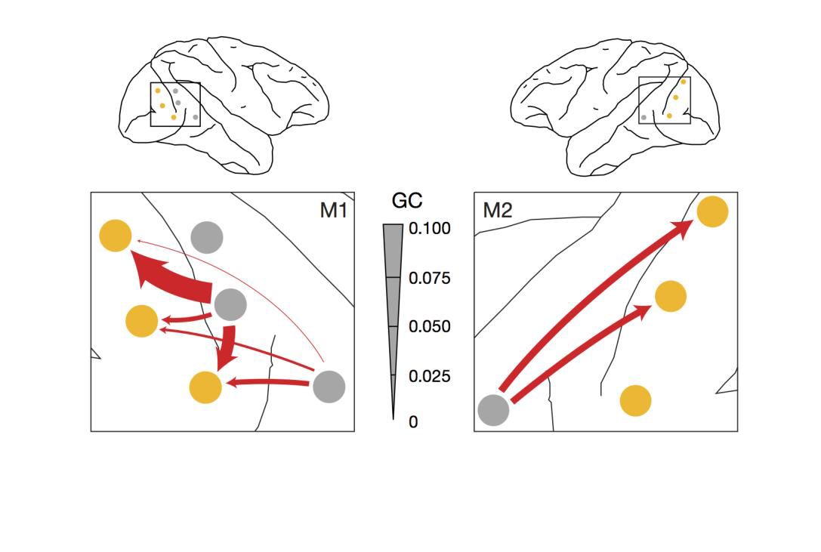
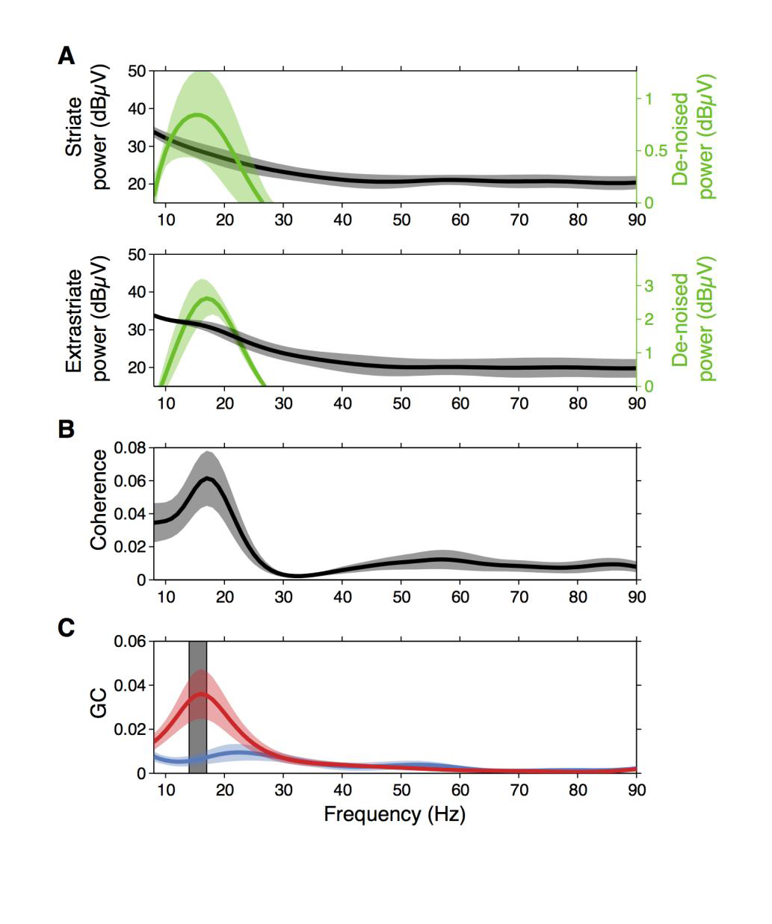
Functional Connectivity of Cortical LFPs in Macaque Visual System Bressler & Richter, 2014, Current Opinion in Neurobiology
Top-down processing in the visual cortex was found to underlie predictive coding & attentional set.
Functional Connectivity was seen as interareal oscillatory synchrony & directed influences in the beta frequency range.

Slide 7
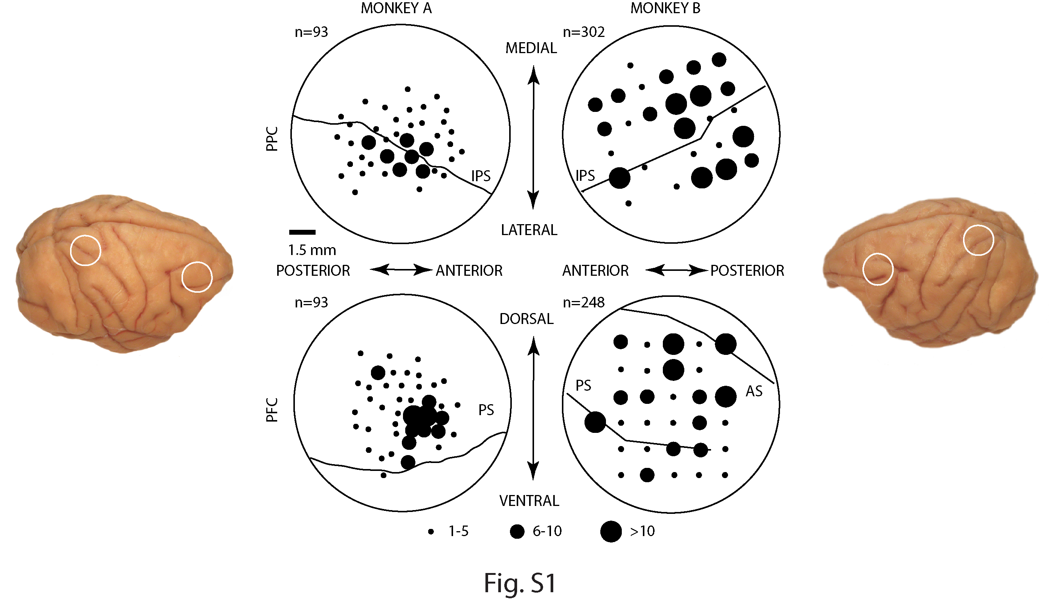
Gray Recording Paradigm
Semi-Chronic Implant
Monopolar Electrodes
Multiple Electrode Sites in 2 Regions
Simultaneous Spike & LFP Recording

Slide 8
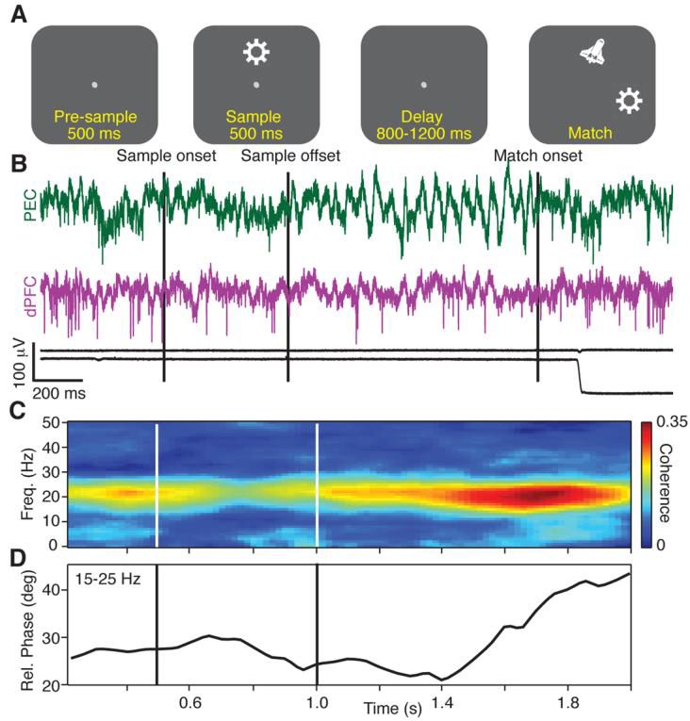
Functional Connectivity of Cortical LFPs in Macaque Parieto-Frontal System Salazar et al., 2012, Science
Interareal beta frequency synchrony of LFPs from posterior parietal and dorsolateral prefrontal cortices coded for visual working memory content.

Slide 9
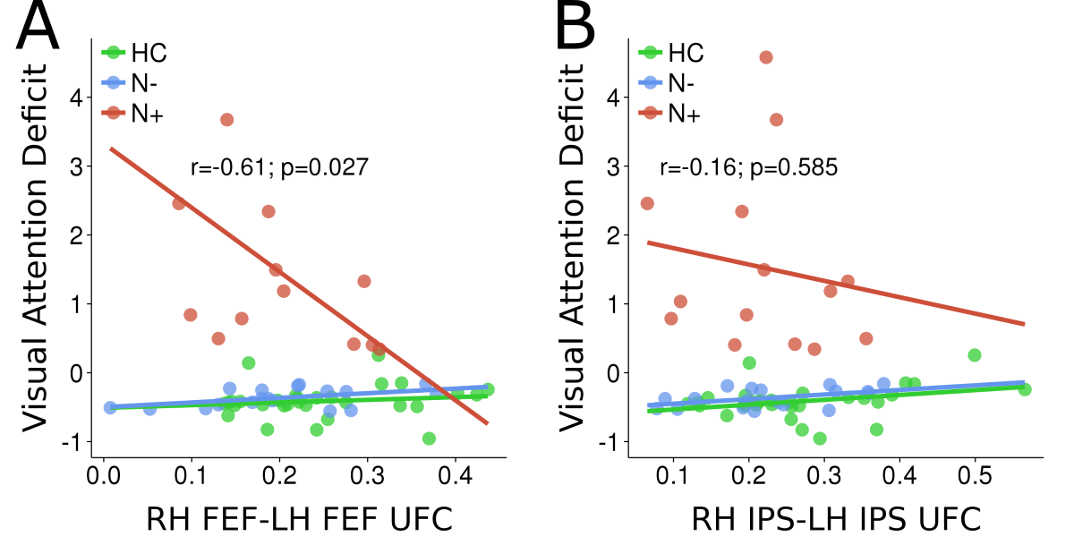
Functional Connectivity of Cortical BOLD Signals in Human Dorsal Attention System Bressler et al., 2008, J Neuroscience Tang et al., 2012, PLoS Computational Biology Meehan, 2016, PhD Dissertation
Functional Connectivity analysis of the Dorsal Attention Network (DAN), and its interactions with the Visual Occipital Cortex (VOC), revealed that stroke-induced lesions alter intrahemispheric functional connectivity within the DAN and with the VOC, leading to interhemispheric functional connectivity imbalances that strongly correlate with behavioral deficit in spatial-neglect patients.

Slide 10
Frequency-Domain Functional Connectivity of Human EEG Sources
Human EEG recording provides a noninvasive fast-timescale signal of brain activity.
Human EEG source analysis offers the potential for a noninvasive fast-timescale measure of cortical source activity.
Technologies are available to perform human EEG recording with minimal preparation time, mobility, and telemetry.
It is technically feasible to perform Functional Connectivity analysis of human EEG cortical source data in real time using high-performance computing.

Slide 11
Source Localization & Functional Connectivity Analysis
The key to human frequency-domain functional connectivity analysis of EEG sources is to determine the Primary Current Density (PCD) from the human scalp-recorded EEG. [See Paz-Linares et al. (2016)].
To determine the PCD from an arbitrary scalp EEG distribution (V) means solving the inverse problem.
To solve the inverse problem, one must know the Electric Lead Field (ELF), which is usually estimated by making assumptions about head geometry and electrical conductivity.
Once V and the ELF are known, the PCD can be obtained.

Slide 12
Solving the Inverse Problem
Since the number of recording electrodes (N) is typically small compared to the number of generators in the PCD (S), the inverse problem, in general, is ill-posed, i.e., it has many equivalent solutions.
Solving the inverse problem thus requires the imposition of additional constraints.

Slide 13
Solutions to the Inverse Problem
Valdes-Sosa and colleagues have proposed a mixed-norms approach to the inverse problem, where L1 and L2 penalty functions are used as constraints.
Cheung et al. (2010) assume that cortical signals arise from known regions. They propose simultaneously solving state (MVAR model) and observation (relating PCD and scalp EEG) equations to estimate an MVAR model of cortical functional connectivity from the scalp EEG.

Slide 14
Take-Home Message
Neurocognitive networks support higher-level functions in the cerebral cortex.
Synchronized beta-frequency oscillations underlie neurocognitive network interactions.
Techniques are being developed and tested to solve the inverse problem and estimate PCD Functional Connectivity from the scalp EEG.
One can envision that Functional Connectivity of human patient EEGs will provide neuromarkers to augment clinical decision-making and provide patient-specific neural information to guide brain stimulation.

